Slide 1
Database Applications and Information Systems
Topic: SQL (1)
Dr. Dan Lin

Slide 2
From Theory to Practice
The Entity-Relationship Model: a convenient way of representing the world.
The Relational Model: a model for organizing data using tables.
Oracle Database: a database infrastructure which implements the relational model.
SQL(Structured Query Language): A language used to get information from a database.

Slide 3
Outline
Create/drop tables
Insert/delete/update data in tables
Query database

Slide 4
Database Systems
Oracle
MySQL
SQLite
PostgreSQL

Slide 5
Create and Delete Tables in SQL

Slide 6
CREATE TABLE Command
The basic format of the CREATE TABLE command is:
CREATE TABLE TableName(
Column1 DataType1 ColConstraint,
…
ColumnN DataTypeN ColConstraint,
TableConstraint1,
…
TableConstraintM
);

Slide 7
Example
SQL> CREATE TABLE DEPARTMENT (
DNAME VARCHAR(15) NOT NULL,
DNUMBER INT,
MGRSSN CHAR(9) NOT NULL,
MGRSTARTDATE DATE,
PRIMARY KEY (DNUMBER)
);
Don’t forget the semicolon ;

Slide 8
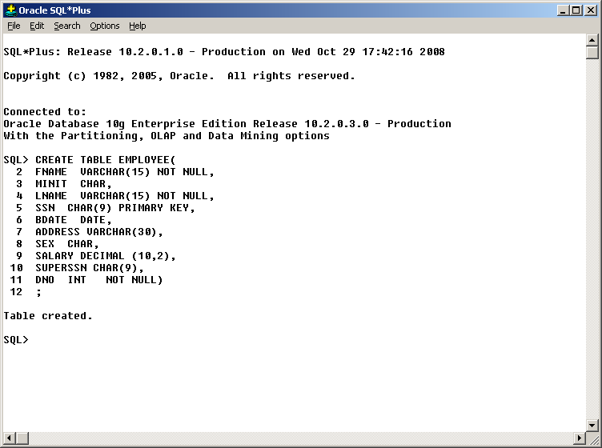
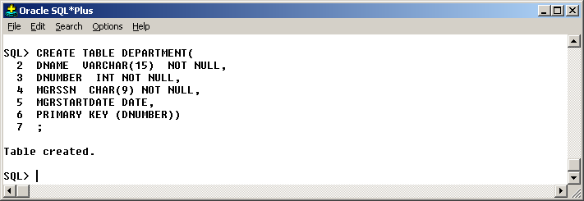
Example
Create tables EMPLOYEE and DEPARTMENT

Slide 9
Data Types
INT or INTEGER.
REAL or FLOAT.
CHAR(n) = fixed length character string, padded with “pad characters.”
VARCHAR (n) = variable-length strings up to n characters.

Slide 10
Data Types
5. NUMERIC(precision, decimal) is a number with precision digits with the decimal point decimal digits from the right.
  NUMERIC(10,2) can store ±99,999,999.99
DATE and TIME
Others
  Boolean
  Interval
  ……

Slide 11
Specify Constraints

Slide 12
Constraints in Create Table
Adding constraints to a table enables the database system to enforce data integrity.
However, adding constraints also makes inserting data slower.
Different types of constraints:
  Not Null
  Default Values
  Unique
  Primary Key
  Foreign Key
  Check Condition

Slide 13
Not Null Constraint
Not Null = every tuple must have a real value for this attribute.
CREATE TABLE Employee(
ID INTEGER NOT NULL,
Fname VARCHAR(20),
Lname VARCHAR(20),
Gender CHAR(1),
Salary INTEGER NOT NULL,
Dept INTEGER
);

Slide 14
Default Values
Default value = a value to use whenever no other value of this attribute is known.
CREATE TABLE Employee(
ID INTEGER NOT NULL,
Fname VARCHAR(20),
Lname VARCHAR(20),
Gender CHAR(1) default ‘F’,
Salary INTEGER NOT NULL,
Dept INTEGER
);

Slide 15
Example
Insert Into Employee(id, Salary)
Values(123,80000);
id | Fname | Lname | Gender | Salary | Dept
123 | NULL | NULL | F | 80000 | NULL

Slide 16
Example
Insert Into Employee(id, Salary)
Values(123,80000);
Insert Into Employee(id, Dept)
Values(100,01);
This operation will be rejected because Salary cannot be NULL.
id | Fname | Lname | Gender | Salary | Dept
123 | NULL | NULL | F | 80000 | NULL

Slide 17
Declaring Keys
Each table can have only one Primary key, but many UNIQUE’s.
SQL does not allow NULL in primary key, but allows them in “unique” columns (which may have two or more nulls, but not repeated non-null values).

Slide 18
Declaring Keys
Two places to declare:
After an attribute’s type, if the attribute is a key by itself.
As a separate element.
  Essential if the key contains more than one attribute.

Slide 19
Unique Constraint (Syntax 1)
CREATE TABLE Employee(
ID INTEGER UNIQUE NOT NULL,
Fname VARCHAR(20),
Lname VARCHAR(20),
Gender CHAR(1) default ‘F’,
Salary INTEGER NOT NULL,
Dept INTEGER
);

Slide 20
Unique Constraint (Syntax 2)
CREATE TABLE Employee(
ID INTEGER NOT NULL,
Fname VARCHAR(20),
Lname VARCHAR(20),
Gender CHAR(1) default ‘F’,
Salary INTEGER NOT NULL,
Dept INTEGER,
UNIQUE(ID)
);

Slide 21
Question – Are they the same?
  CREATE TABLE Sells (
  bar CHAR(20),
  beer VARCHAR(20),
  price REAL,
  UNIQUE(bar,beer)
  );
  CREATE TABLE Sells (
  bar CHAR(20) UNIQUE,
  beer VARCHAR(20) UNIQUE,
  price REAL
  );

Slide 22
Primary Key Constraint (Syntax 1)
CREATE TABLE Employee(
ID INTEGER PRIMARY KEY,
Fname VARCHAR(20),
Lname VARCHAR(20),
Gender CHAR(1),
Salary INTEGER NOT NULL,
Dept INTEGER,
UNIQUE (FNAME,LNAME)
);
Primary Key implies: NOT NULL and UNIQUE.

Slide 23
Primary Key Constraint (Syntax 2)
Suppose that the primary key is (Fname, Lname).
CREATE TABLE Employee(
ID INTEGER,
Fname VARCHAR(20),
Lname VARCHAR(20),
Gender CHAR(1),
Salary INTEGER NOT NULL,
Dept INTEGER,
PRIMARY KEY(Fname,Lname)
);

Slide 24
CREATE TABLE Employee(
ID INTEGER primary key,
Fname VARCHAR(20),
Lname VARCHAR(20),
Gender CHAR(1),
Salary INTEGER NOT NULL,
Dept INTEGER );
CREATE TABLE Department(
DeptNumber INTEGER PRIMARY KEY,
Name VARCHAR(20),
ManagerId INTEGER
);
Shouldn’t all department numbers in Employee appear in Department

Slide 25
Employee
ID | FName | LName | Gender | Sallary | Dept
02334 | Larry | Bird | M | 80000 | 12
04556 | Magic | Johnson | M | 70000 | 45
Foreign Key
Department
DeptNumber | Name | ManID
12 | Sales | 988
45 | Repair | 876

Slide 26
Foreign Key Constraint (Syntax 3)
CREATE TABLE Employee(
ID INTEGER primary key,
Fname VARCHAR(20),
Lname VARCHAR(20),
Gender CHAR(1),
Salary INTEGER NOT NULL,
DeptNumber INTEGER,
FOREIGN KEY (DeptNumber) REFERENCES Department (DeptNumber)
);

Slide 27
What Happens When a Foreign Key Constraint is Violated?
1. Insert or update a Employee tuple that refers to a nonexistent Dept in the Department table.
  Always rejected
2. Delete or update Dept in the Department table that some Employee tuples refer to.
  Reject by default
  CASCADE
  SET NULL or SET DEFAULT

Slide 28
Example
CREATE TABLE Employee(
ID INTEGER primary key,
DeptNumber INTEGER Default -1,
FOREIGN KEY (DeptNumber) REFERENCES Department (DeptNumber)
ON DELETE CASCADE
ON UPDATE SET DEFAULT
);
Case 1: If Dept 123 is deleted from Department table, all tuples in Employee table with DeptNumber 123 will be automatically deleted.
Case 2: If Dept 123 is updated to 100 in the Department table, the value of Dept in Employee tuples which is 123 will be automatically set to -1.

Slide 29
Giving Names to Constraints
CREATE TABLE Employee (
ID INTEGER,
Fname VARCHAR(20),
Lname VARCHAR(20),
Gender CHAR(1),
Salary INTEGER NOT NULL,
CONSTRAINT Dept_Primarykey
Primary key (ID)
);
Note 1: names of the constraints in the same relation must be unique
Note 2: it is useful when the constraint needs to be dropped later.

Slide 30
We are going to see the CHECK constraint in the next class

Slide 31
Delete Table

Slide 32
Delete a Table
Basic Format:
DROP TABLE Table_name RESTRICT;
DROP TABLE Table_name CASCADE;
“RESTRICT”: drop the table only when it is not referenced.
“CASCADE”: will drop the constraints and views that reference the table
DROP TABLE command remove all records in the table and the table definition.
To delete the table DEPARTMENT:
SQL> DROP TABLE DEPARTMENT CASCADE;

Slide 33
Insert, Delete and Update Data in a Table

Slide 34
Inserting a Row
To insert a row into the Employee table
Employee(id:integer,fname:varchar(20),gender:varchar(1),
deptnumber:integer, salary:integer)
Approach 1: The attributes don’t have to be specified if values are specified for all columns and in the order defined by the table
SQL> Insert Into Employee
Values (122,‘Bob','M',12,110000);

Slide 35
Inserting a Row
To insert a row into the Employee table
Employee(id:integer,fname:varchar(20),gender:varchar(1),
deptnumber:integer, salary:integer)
Approach 2: Only few of attributes are assigned values for the new tuple.
SQL> Insert Into Employee(id,deptnumber)
Values(123,13);

Slide 36
Inserting a Row
Approach 3: use the SQL query to retrieve data from other tables and then insert them into the current table
SQL> Insert Into Employee(id,fname)
Select [attr1], [attr2]
From [table_name]
Where [condition];

Slide 37

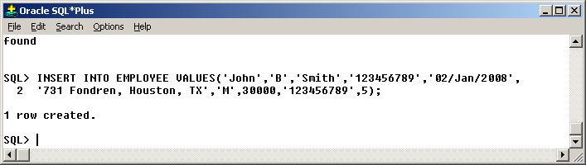
In SQL*PLus

Slide 38
Inserting a Row
The insertion operation will be rejected if it violates the constraints specified in the table definition.

Slide 39
Deleting Rows
General format:
DELETE FROM Table
WHERE Condition;
Deletes all rows satisfying Condition from Table

Slide 40
Example
Remove the employee with id 121 from the Employee table:
DELETE FROM Employee WHERE id = 121;
Remove all employees having a salary greater than 100,000:
DELETE FROM Employee WHERE Salary > 100000;
Remove all records in the Employee table
DELETE FROM Employee;

Slide 41
Deleting Rows
The Condition can also involve SQL queries.
Example:
  DELETE FROM Employee
  WHERE Deptnumber IN (Select Dnumber
  From Department
  Where Dname = `Research’);

Slide 42
Updating Rows
We can update rows in a table
General format:
UPDATE Table
SET Column1=value1,…,ColumnN=valueN
WHERE Condition

Slide 43
Example
Now we can reduce salaries instead of firing employees:
UPDATE Employee
SET Salary = 100000
WHERE Salary > 100000;

Slide 44
Updating Rows
The Condition can also involve SQL queries.
Example:
  UPDATE Employee
  SET Salary = Salary*1.1
  WHERE Deptnumber IN (Select Dnumber
  From Department
  Where Dname = `Research’);

Slide 45
Try These Commands in SQL*Plus
Show the structure of a table
desc table_name
Create a .sql file
ed filename.sql
Execute a SQL file
@filename.sql

Slide 46
Brief Review
Create tables
  Specify various constraints
Drop tables
Insert/delete/update data in tables

Slide 47
Comments?
CREATE TABLE Employee(
ID INTEGER,
Fname VARCHAR(20),
Lname VARCHAR(20),
Gender CHAR(1),
Salary INTEGER NOT NULL,
Dept INTEGER,
PRIMARY KEY(FNAME,LNAME)
);
CREATE TABLE Employee(
ID INTEGER,
Fname VARCHAR(20) PRIMARY KEY,
Lname VARCHAR(20) PRIMARY KEY,
Gender CHAR(1),
Salary INTEGER NOT NULL,
Dept INTEGER,
);
wrong

Slide 48
Some more constraints in CREATE TABLE

Slide 49
CHECK Conditions
A check condition is a Boolean expression:
  E.g.: x>5 and x<10
Attribute-Based Check
Tuple-Based Check

Slide 50
Attribute-Based Check
Follow an attribute by a condition that must hold for that attribute in each tuple of its relation.
Condition is checked only when the associated attribute changes (i.e., an insert or update occurs).

Slide 51
Attribute-Based Check
CREATE TABLE Employee(
ID INTEGER primary key,
Fname VARCHAR(20),
Lname VARCHAR(20),
Gender CHAR(1) check(gender=‘F’ or gender=‘M’),
Salary INTEGER check(Salary>=0),
DeptNumber INTEGER
);
The check occurs only when we insert or update an Employee tuple, not when we delete a tuple.

Slide 52
Tuple-Based Check
Separate element of table declaration.
Checked whenever a tuple is inserted or updated.

Slide 53
Example
Only Joe's Bar can sell beer for more than $5.
CREATE TABLE Sells (
  bar CHAR(20),
  beer CHAR(20),
  price REAL,
  PRIMARY KEY (bar,beer),
  CHECK (bar = 'Joe''s Bar' OR price <= 5.00)
  );

Slide 54
Table Alteration

Slide 55
Altering Tables
Table definitions can be altered after their creation
Use the reserved words ALTER TABLE
Options:
  Adding columns: ADD COLUMN
  Changing columns’ definition: ALTER COLUMN
  Dropping columns: DROP COLUMN
  Adding or dropping constraints: ADD, DROP CONSTRAINT
  And more…

Slide 56
Altering Tables
Adding a column:
ALTER TABLE Employee ADD COLUMN mname VARCHAR(20);
Changing columns’ definition:
  ALTER TABLE Employee Modify mname varchar(10);
Dropping columns:
ALTER TABLE Employee DROP COLUMN Mname CASCADE;
Adding constraints:
  ALTER TABLE Employee ADD check(age>0);

Slide 57
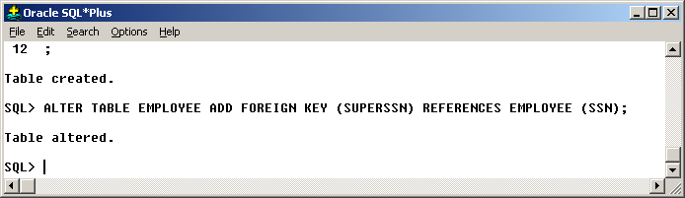
In SQL*Plus

Slide 58
What’s Next
SQL Queries …

